Slide 1

Power BI
- ADITHYAN B
25MIB003

Slide 2
DATASET REGARDING MUSIC ARTIST (DATA CLEANING , DATA MODELING & VISUALIZATION)

Slide 3
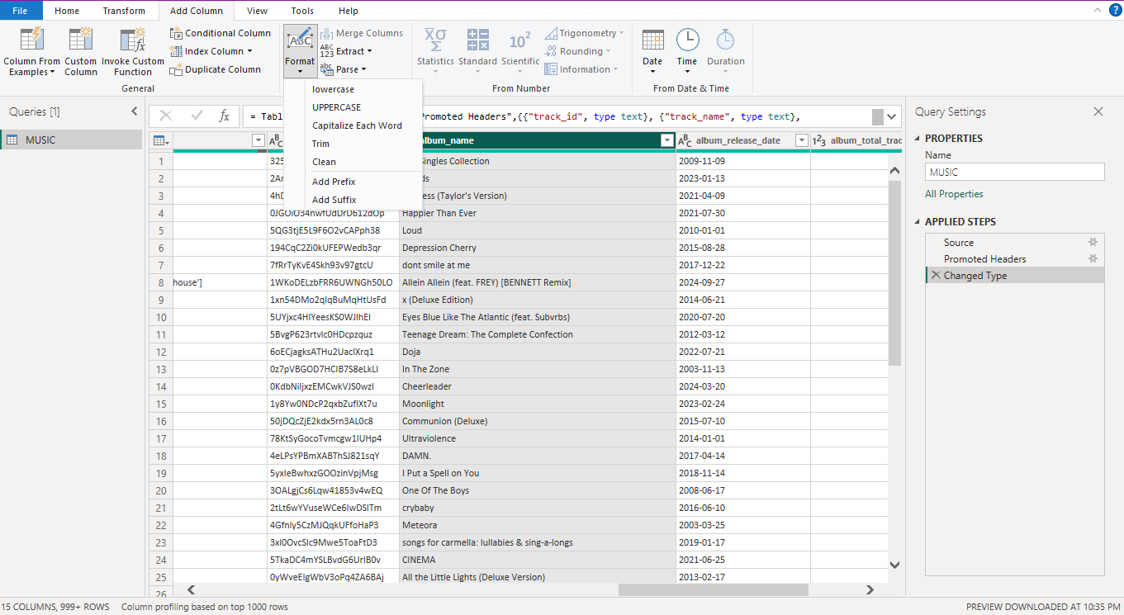
FORMAT
FORMAT IS BEEN USED TO ADD NEW COLUMN OR MODIFY EXITING COLUMN WITH CHARACTERS LIKE LOWERCASE,UPPERCASE,CAPITALIZED , TRIM, CLEAN AND FUNCTIONS LIKE PREFIX AND SUFFIX.

Slide 4
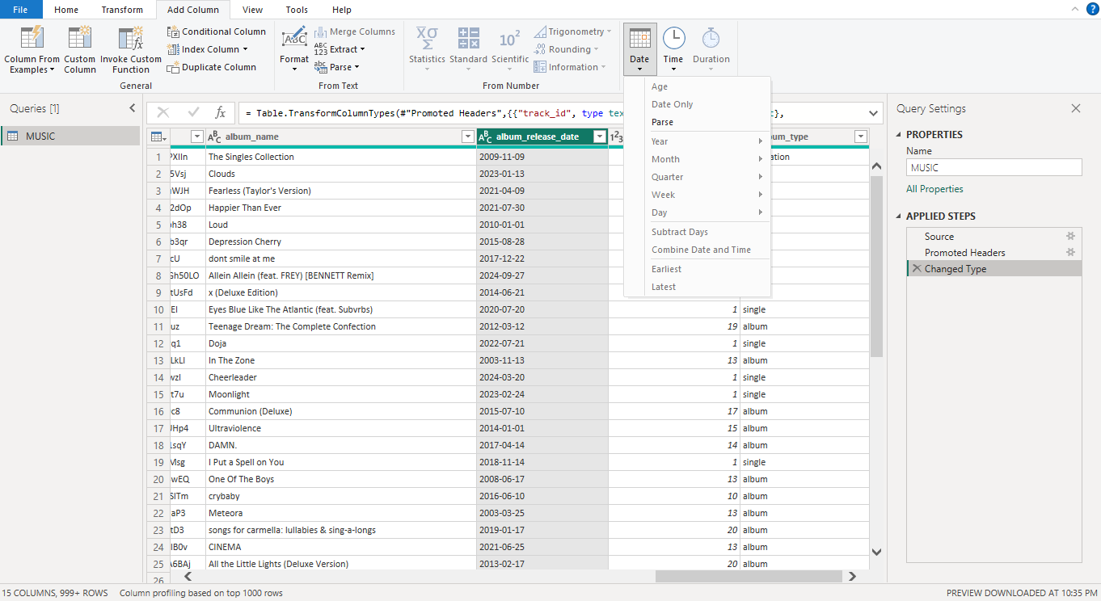
DATE FUNCTION
The date function is used to categorize the current column or create a new column that distinguishes between the following: year, month, week, quarter, day, and age.

Slide 5
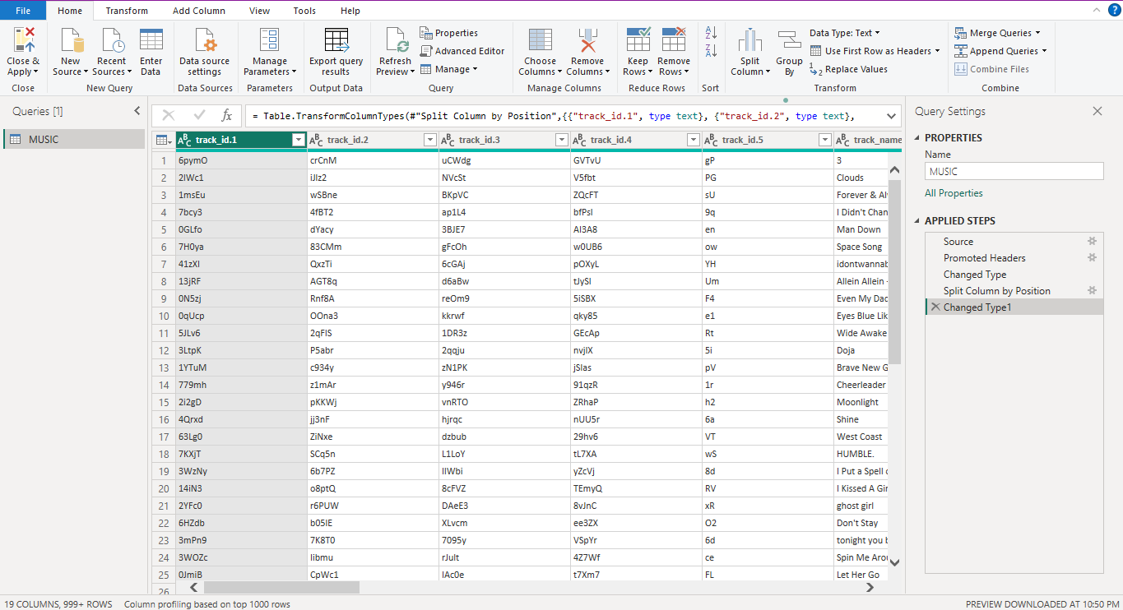
SPLIT COLUMN
SPLITS THE COLUMN WITH ACCORDANCE OF DELIMITER, LENGHTH OF CHARACTER& POSITION.
LOWERCASE TO UPPERCASE & VICE-VERSA
DIGIT TO NON- DIGIT & VICE-VERSA

Slide 6
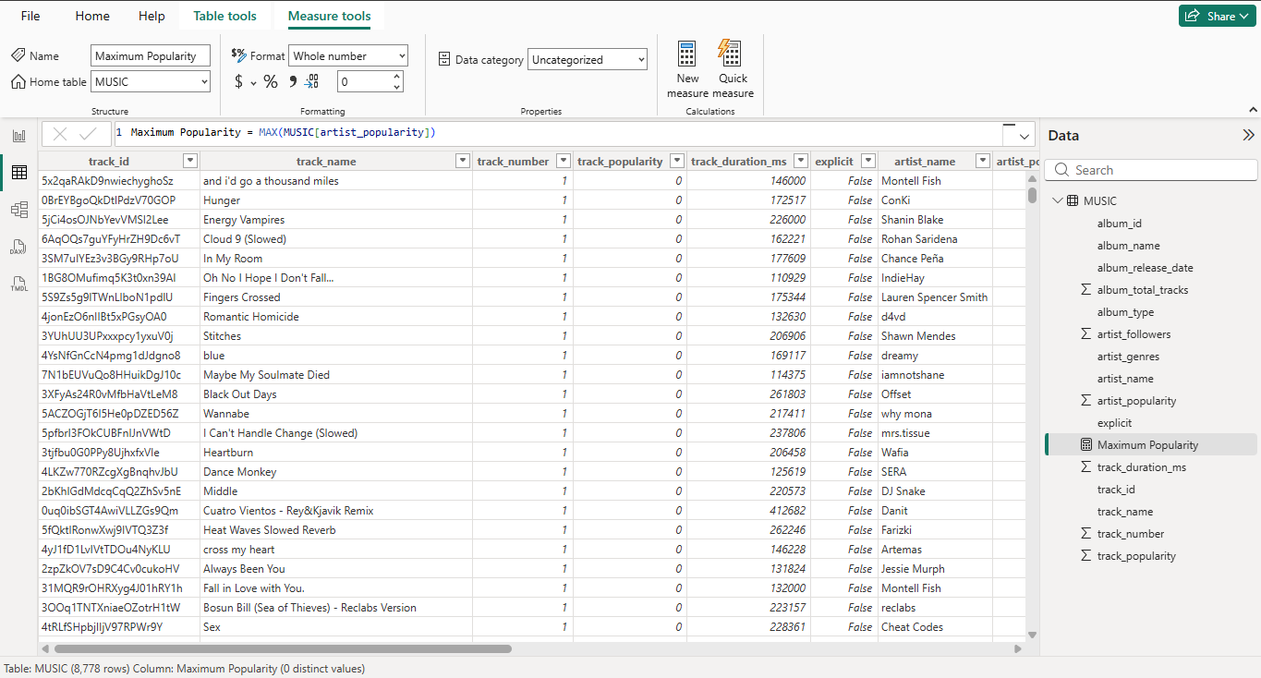
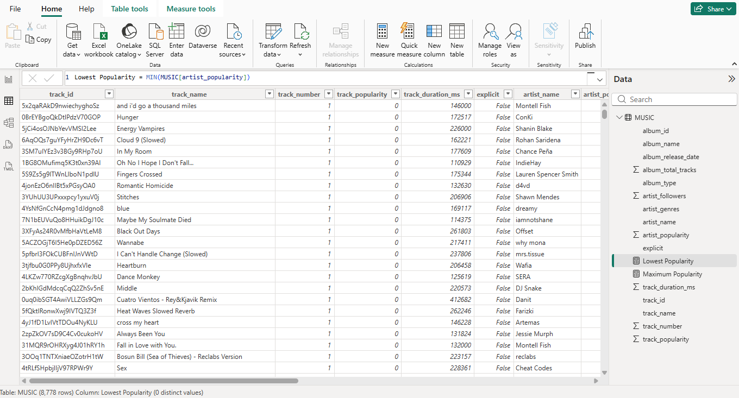
FUNCTION OF MAXIMUM AND MINIMUM
MAX FUNCTION
MIN FUNCTON

Slide 7
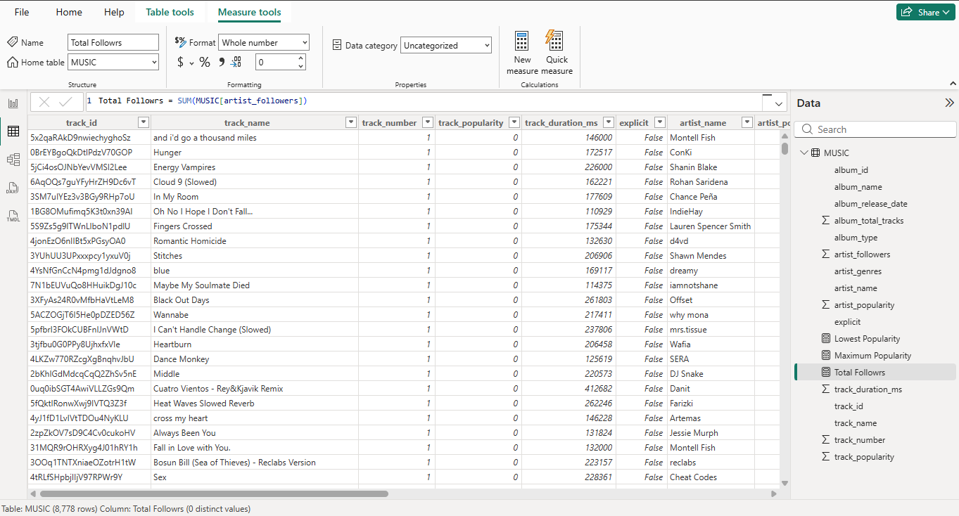
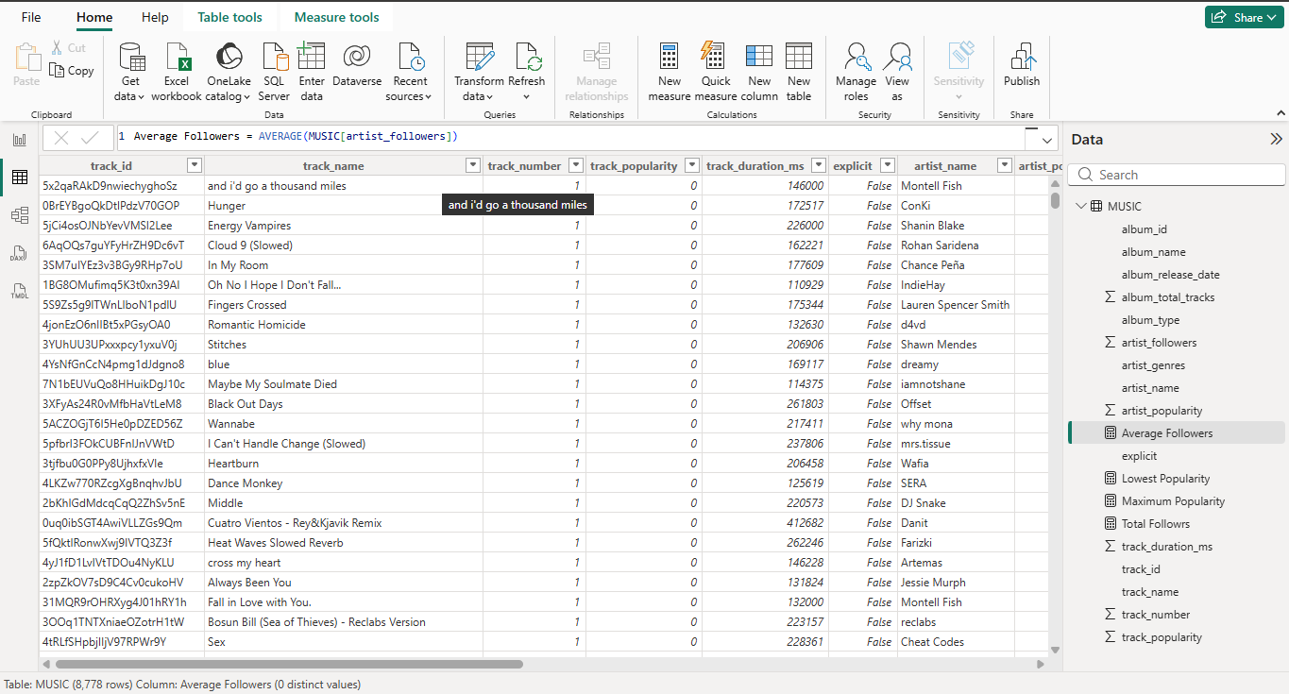
FUNCTION OF SUM AND AVERAGE
SUM FUNCTION
AVERAGE FUNCTION

Slide 8
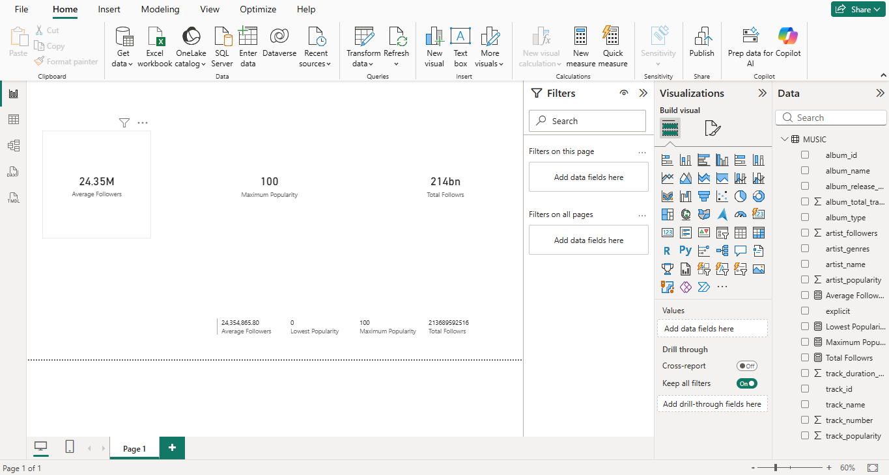
REPORT VIEW

Slide 9
THANK YOU

